Slide 1
APA Chapter 2
Paper Elements and Format

Slide 2
Basic Structure
Title Page
Abstract
Body
References
Body will contain different sections depending on the type of paper

Slide 3
Structure of Published Papers
Manuscript organization with each part starting on its own separate page
  Title page
  Abstract
  Text (body)
    Introduction
    Methods
    Results
    Discussion
  References
  Tables
  Figures
  Appendices (if any)

Slide 4
General Formatting Guidelines
Page order:
  Title page (1)
  Body (immediately after title page)
  References (new page immediately after last body page)
  Tables (new page after references)
  Figures (new page after Tables)

Slide 5
General Formatting Guidelines
Header:
  Page number on all pages (far right corner)
  Running head NOT required for student papers
    Don’t worry about it!
Body
  Double Spaced!
Font:
  Biggest rule is consistency!
  Second biggest rule is legibility
  Black ink only please…
  11-pt or 12-pt

Slide 6
Font Guidelines
Don’t do this.
Or this…
This is also bad
or this…
https://apastyle.apa.org/style-grammar-guidelines/paper-format/font

Slide 7

Good choices are Times New Roman (serif), Arial (sans serif, or Calibri (sans serif)

Slide 8
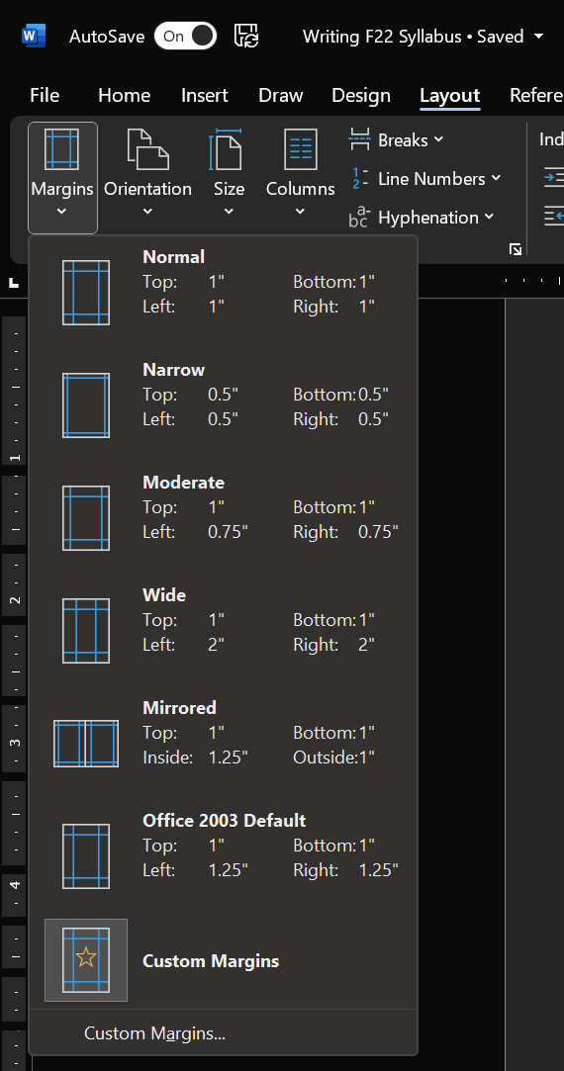
Formatting Margins
Set margins to 1 inch on all sides (default)
Text should align left (default)
Double space all text
First line of each paragraph should indent .5 inches (default)

Slide 9
Heading Levels
Headings have five different levels (see hand-out on D2L)
https://apastyle.apa.org/style-grammar-guidelines/paper-format/headings

Slide 10
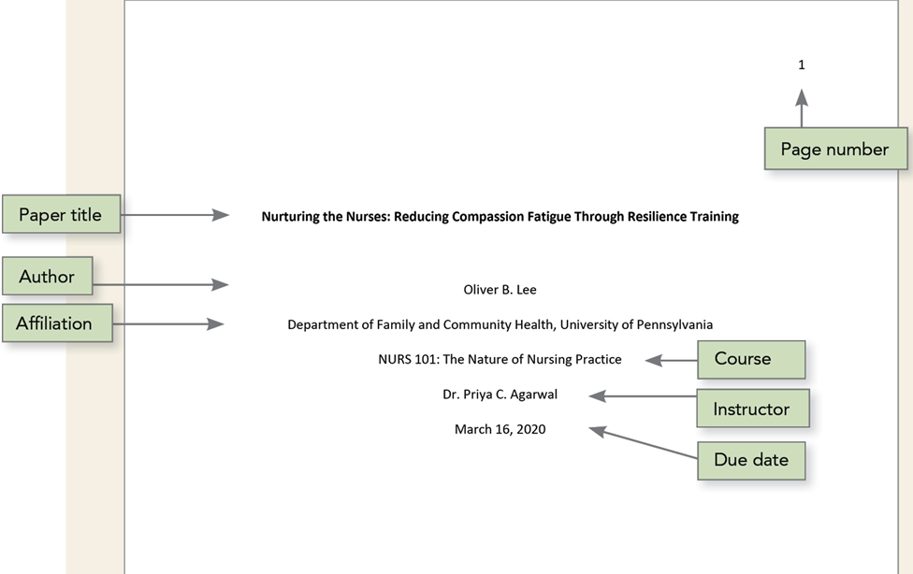
APA Recommended Student Title Page

Slide 11
Formatting Your Title Page
Dr. Maxwell requires:
  The title (obviously)
  Your name (please don’t forget this)
  Course number (helps me keep things straight)
  Page number (top right corner)
  Draft # and Due Date (below course number)
Don’t worry about including:
  Affiliation (I know where you go to school)
  Instructor name (I know who I am)

Slide 12


Slide 13
What’s in a Name (Title)?
Your title should summarize the main idea of the paper
Simple == Good
Mixed views on puns or jokes in title (I think they’re fun…)

Slide 14
Abstract
The abstract is a brief, comprehensive summary of a paper’s contents (no more than 250 words)
NOT REQUIRED FOR STUDENT PAPERS!
A good abstract will immediately let you know if an article is worth your time
  (you will read lots of abstracts as you research for your term paper)

Slide 15
Main Body Sections
Body sections will differ depending on a paper’s goals
For Research Articles:
  Introduction (heading is the title)
  Methods
  Results
  Discussion

Slide 16
Introduction
First section introduces the topic:
  First paragraph – What is the topic and what is the central research question?
  Middle paragraphs – What’s already been done? Historical overview/background literature
  Last paragraph – What’s the goal of the paper? Why did the author conduct this research?
Note: No “Introduction” heading; just use the paper title as the heading
Insert a page break to start this section! (Title page should be separate)

Slide 17
Methods
What process did the researchers use?
Three subheadings:
  Participants
    Who were the participants? How many? Were they paid?
  Materials
    What did you use?
  Procedure
    How did you do the thing? Was data collected online or in-person? How long was the experiment?

Slide 18
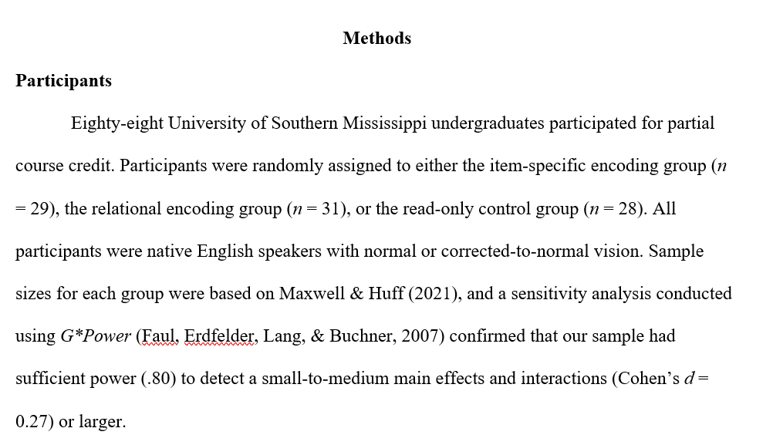
Participants Section Example

Slide 19
Results
What did the researchers find?
  Statistical analyses are reported here
  Figures and Tables go here too
Confused by the stats? Start with the tables or Figures!

Slide 20
Discussion/General Discussion
Do the results support the research question?
What are the implications
Future directions?
Limitations

Slide 21
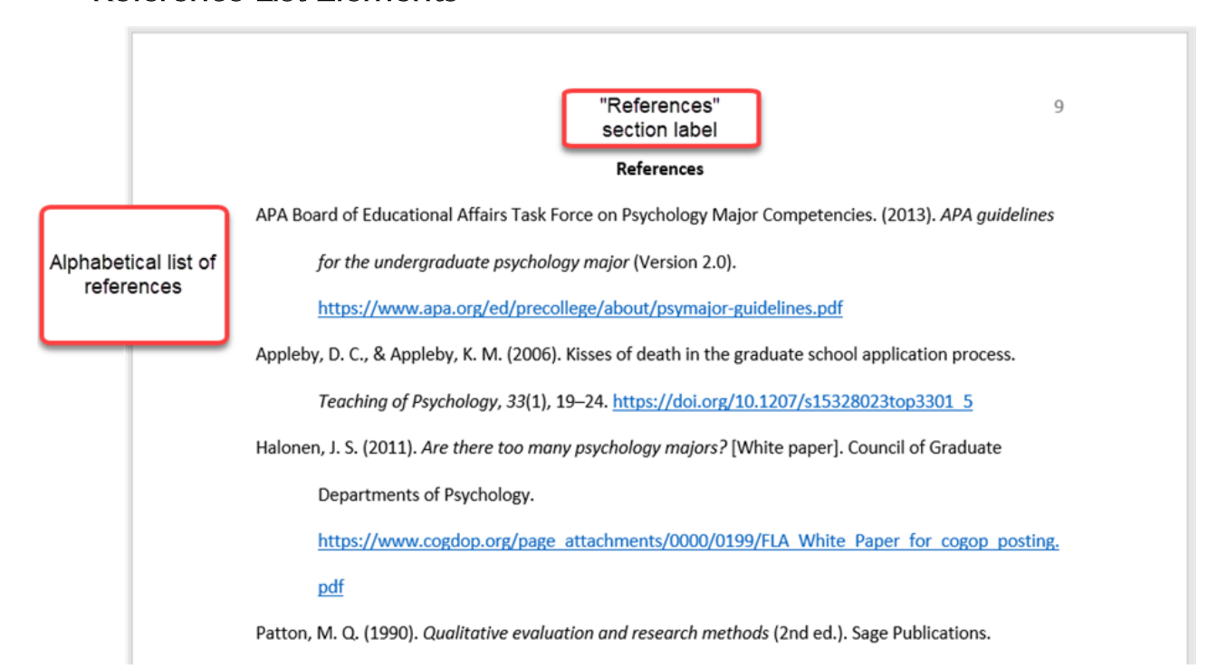
Formatting the Reference Page

Slide 22
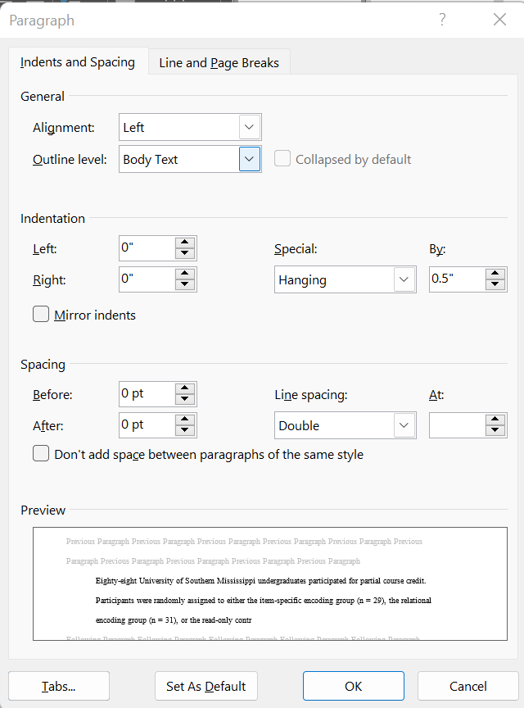
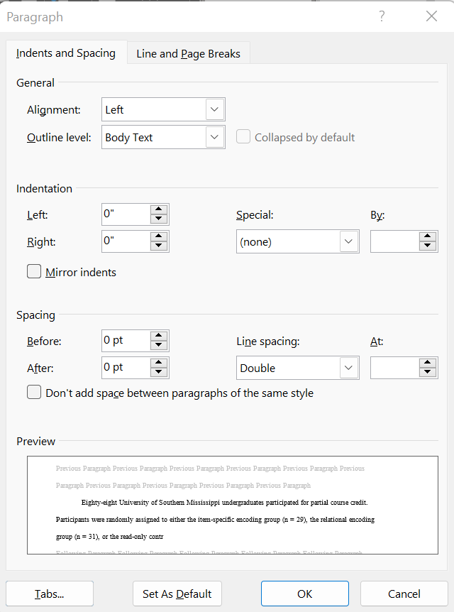
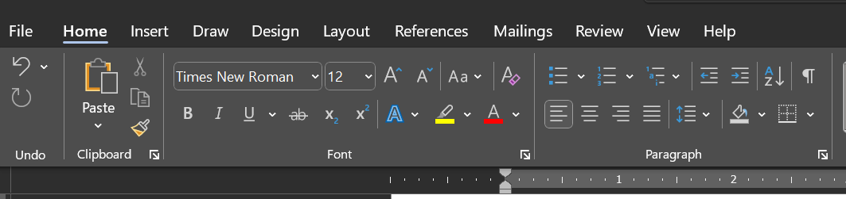
Hanging Indent in Word

Slide 23

Questions so Far???

Slide 24
Online Resources
https://apastyle.apa.org/
https://owl.purdue.edu/owl/research_and_citation/apa_style/apa_style_introduction.html
–

Slide 25
So What’s Required of You?
Introduction Paragraph(s)
Body of paper should focus on different studies you’re comparing/contrasting

Slide 26
Tips for you!
For your paper, I suggest:
  Roadmap paragraph
    Provide general purpose statement
    Provide specific purpose statement
  Then begin introducing each topic (article you’re evaluating)
    Each should get its own section
      Topic 1
      Topic 2
      Topic 3
    Remember to have transitions between paragraphs
    Each section should have at least 2-3 paragraphs in them
Notes:
The first paragraph is the ‘roadmap paragraph’
Indicates the general topic, and what the problem/purpose is
Provides an overview of what is to come (rest of the paper)
May hint at the hypotheses

Slide 27
Purpose Statements
When you read an article, there are certain parts that may be helpful for you to look at:
  The introduction
    Gives a sense of the purpose of what you will discuss
    Gives a sense of the previous literature, which may assist in writing introduction
  It is important for researchers to make it clear what they are studying, and why.
    General purpose statement: Generally, why is the topic important?
    Specific purpose statement: Specifically, what will you be looking at in your paper?

Slide 28
Framing your Introduction
Use a “triangle” to guide your introduction
General Topic Area
Specific Research Question

Slide 29
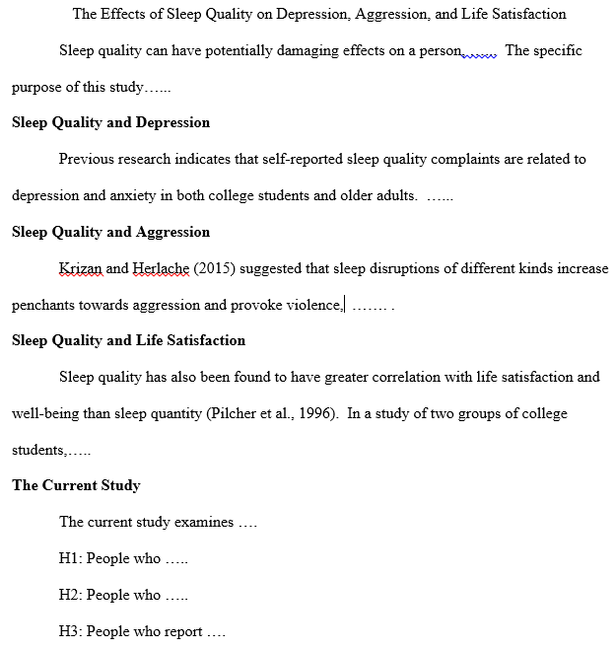
Example structure of an introduction section

Slide 30
Things to consider when organizing writing…
Headings will improve the flow of the paper
  Specific topics for each heading
  Two separate sections from headings in the introduction
  Typically a third section that synthesizes the two points
  Proposed study section
Conventions
  At least 2 paragraphs per heading
  At least 3 sentences per paragraph
  Avoid citing a paper as the topic sentence
  Avoid using the authors of a paper as a subject of the sentence unless necessary
Connect your ideas!
  I have seen many interesting ideas fall apart because the writing had no logical flow to it

